Slide 1
Lecture 2 Divide & Conquer: Peak Finding
Spring 2026
Zhihua Jiang

Slide 2
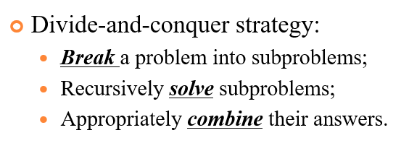

Slide 3
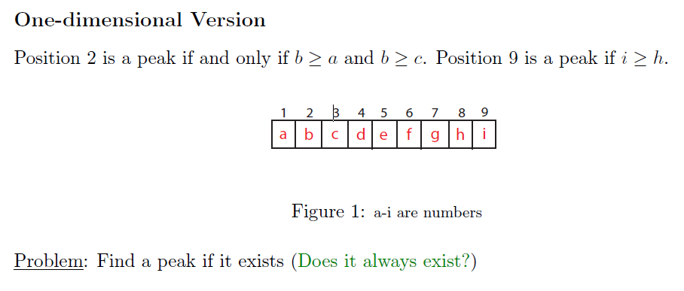
Ex. Peak Finder
Hint: Given the above definition ≥, a peak always exists!
However, if only >, a peak does not always exist, e.g., y(x)=c.
Notes:
Sometimes there is more than one peak. The problem is to find any peak.

Slide 4
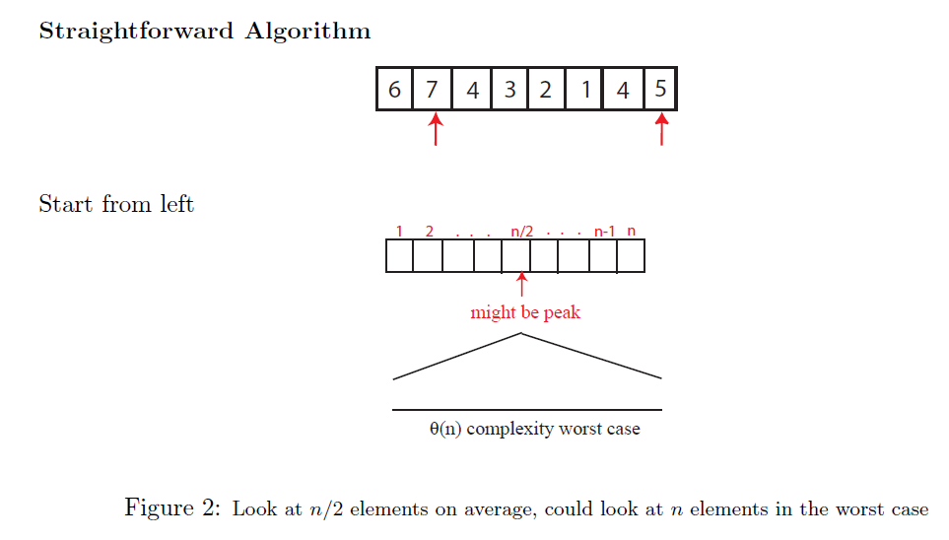
Peak Finder
Notes:
Visit each element from left to right
Average: (1+2+…+(n-1))/(n-1)=(n*(n-1))/2(n-1)=n/2
E1 is a peak, need to look at 1 element
E2 is a peak, need to look at 2 elements
E3 is a peak, need to look at 3 elements
E_n-1 is a peak, need to look at n-1 elements
E_n is a peak (definitely), need to look at 0 elements

Slide 5
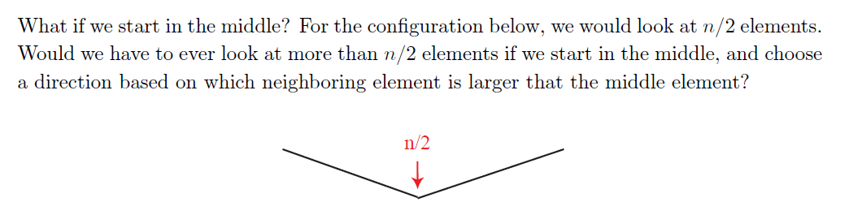
Peak Finder
than

Slide 6
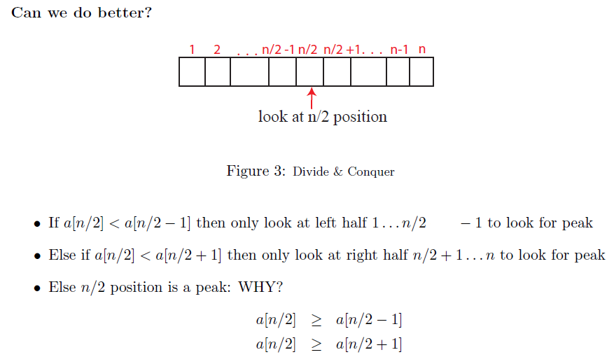
Peak Finder
n/2-1

Slide 7
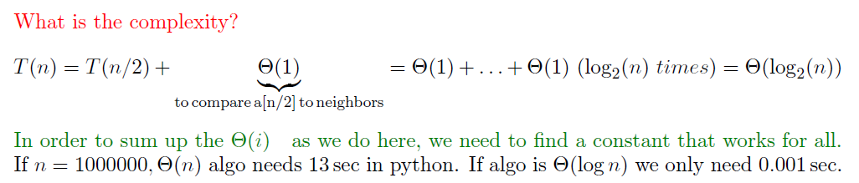
Peak Finder

Slide 8
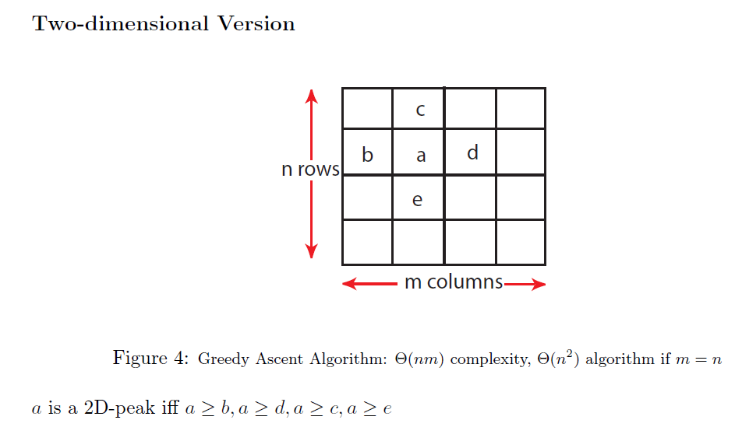
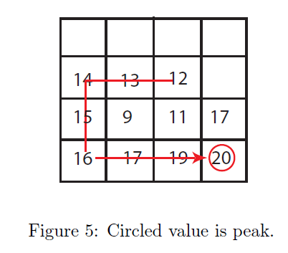
Peak Finder
Notes:
Greedy: follow the largest neighbor.

Slide 9
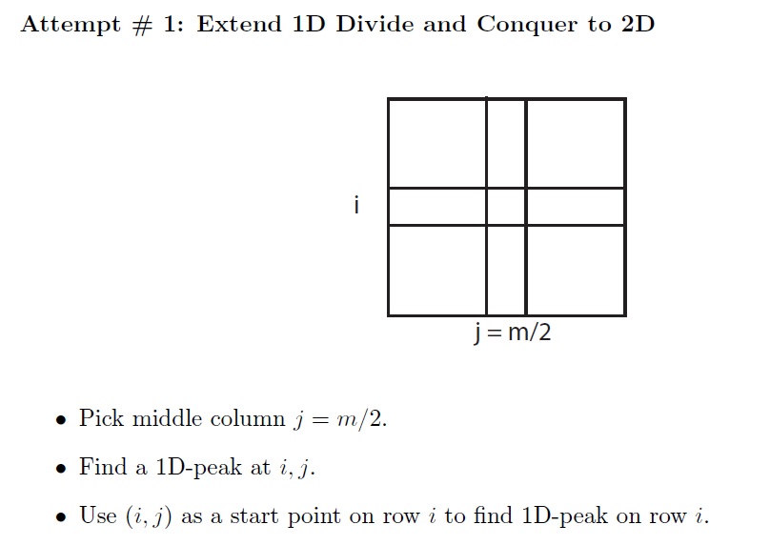
Peak Finder
Notes:
O(m+n)

Slide 10
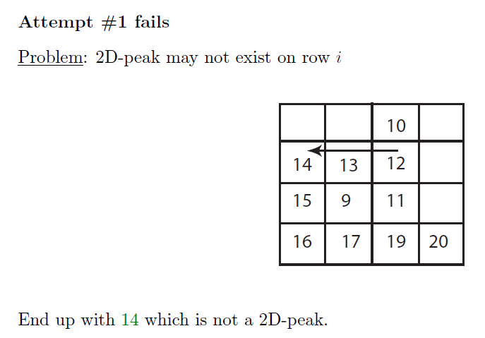
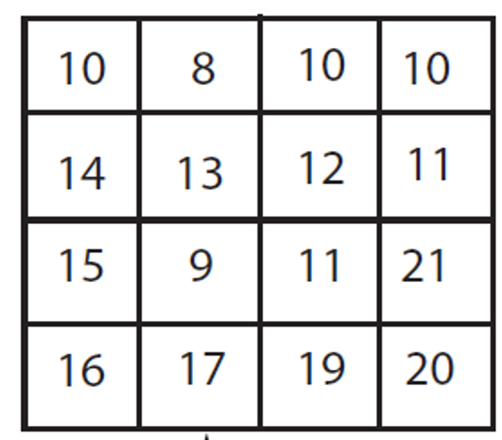
Peak Finder

Slide 11
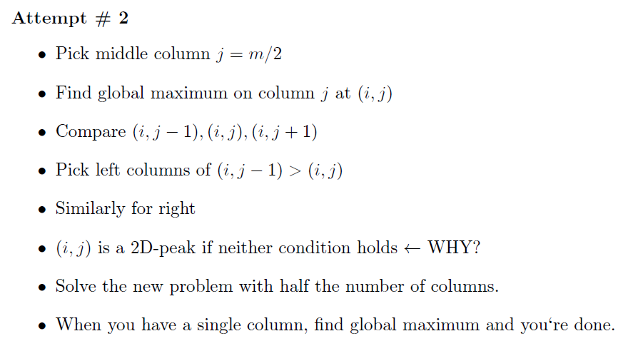
Peak Finder
Loop: Solving subproblems
Notes:
Pick right columns of (i, j+1)>(I,j)

Slide 12
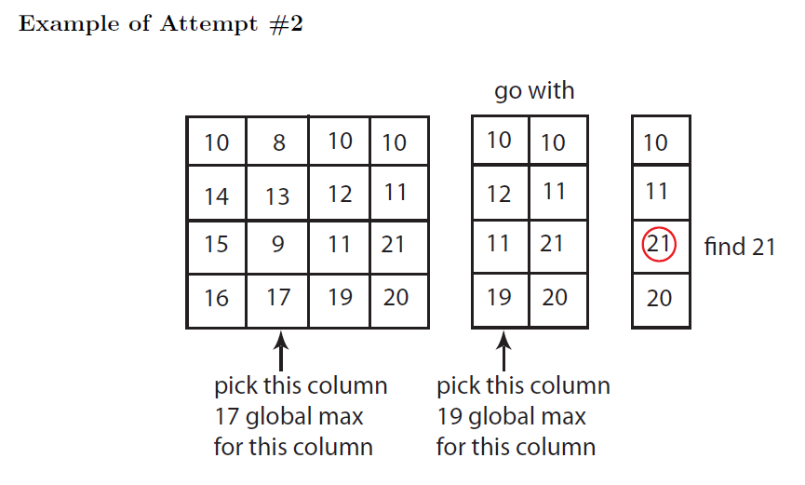
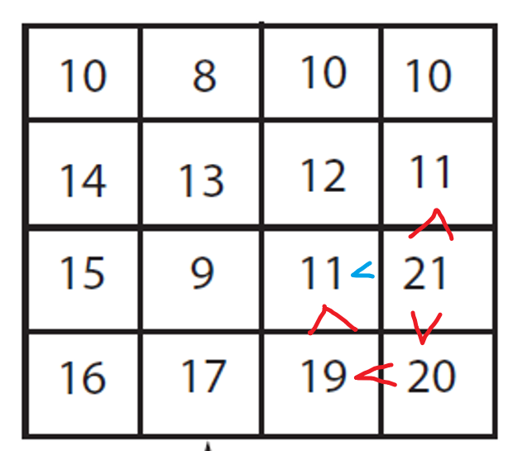
Peak Finder
Q: Why global max works?
Notes:
21(max/peak)>20(larger neighbor of 19)>19(max)>11(neighbor of 21)

Slide 13
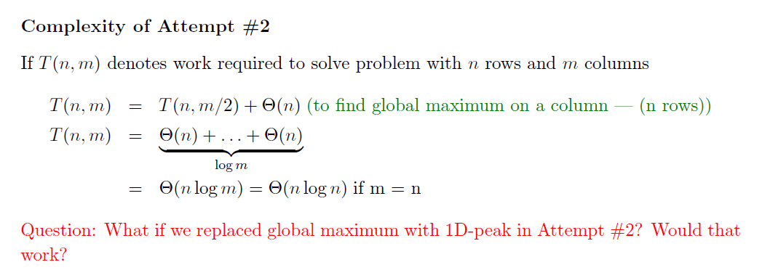
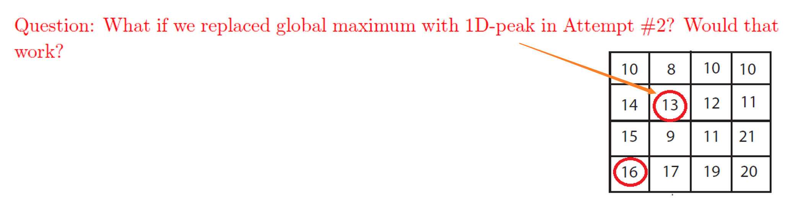
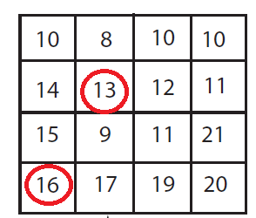
Peak Finder
General:
if m>>n, then middle collum m/2; if n>>m, then middle row n/2;
finally, O(min{m,n}log(max{m,n}))
Notes:
if m>>n, then m/2;
if n>>m, then n/2;
anyway, O(min{m,n}log(max{m,n}))
T(n,m)=T(n,1)+logmO(n)

Slide 14
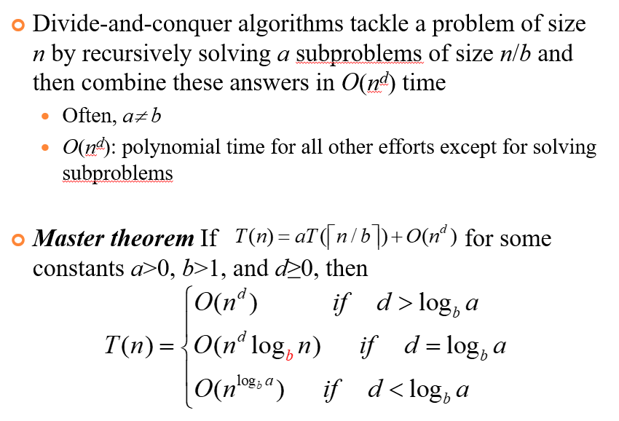

Slide 15
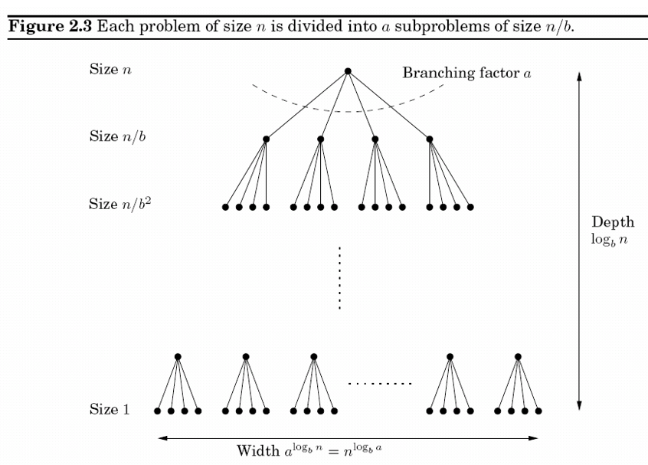

Slide 16
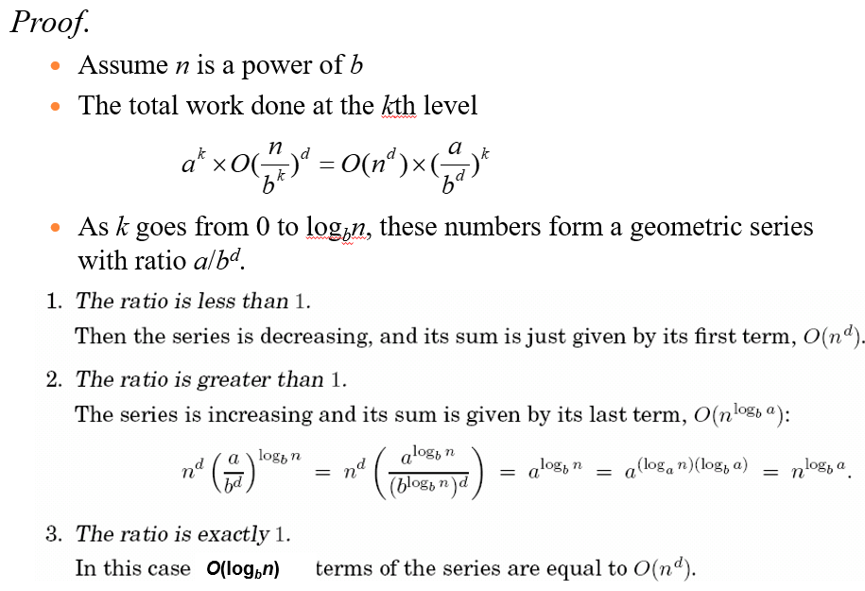

Slide 17
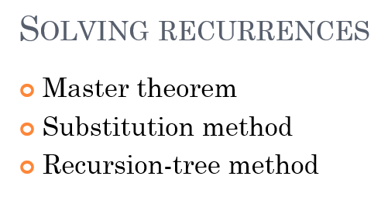

Slide 18
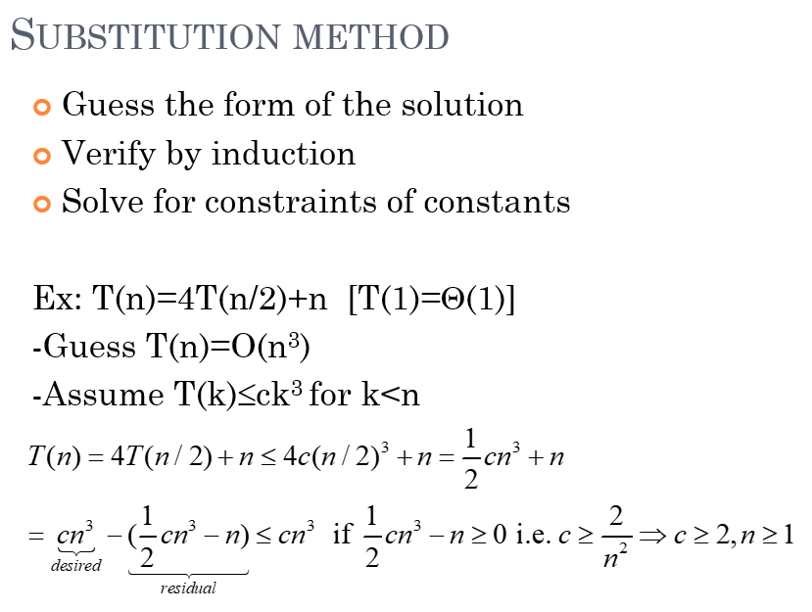

Slide 19
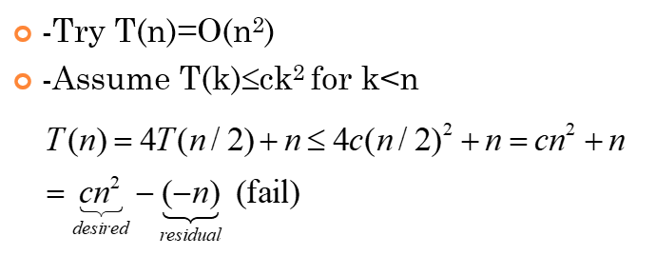
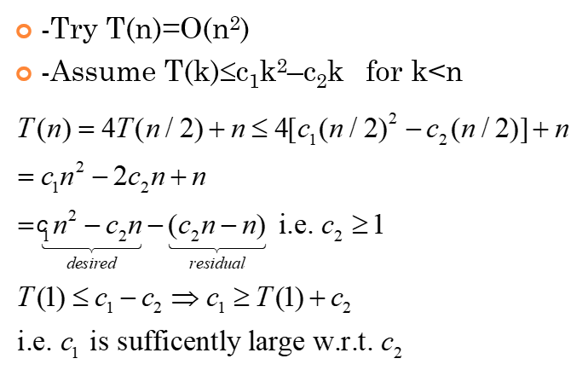

Slide 20
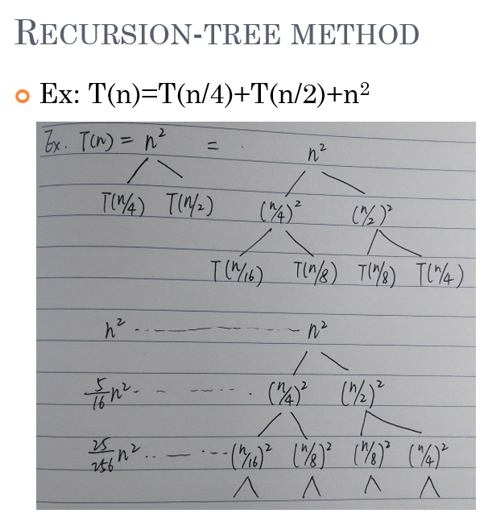
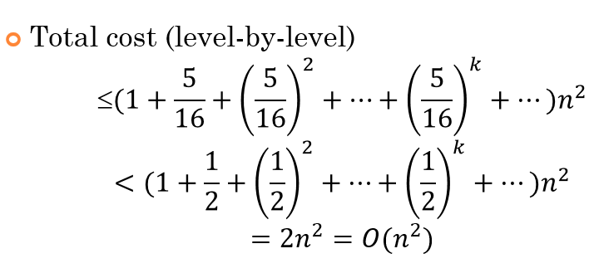

Slide 21
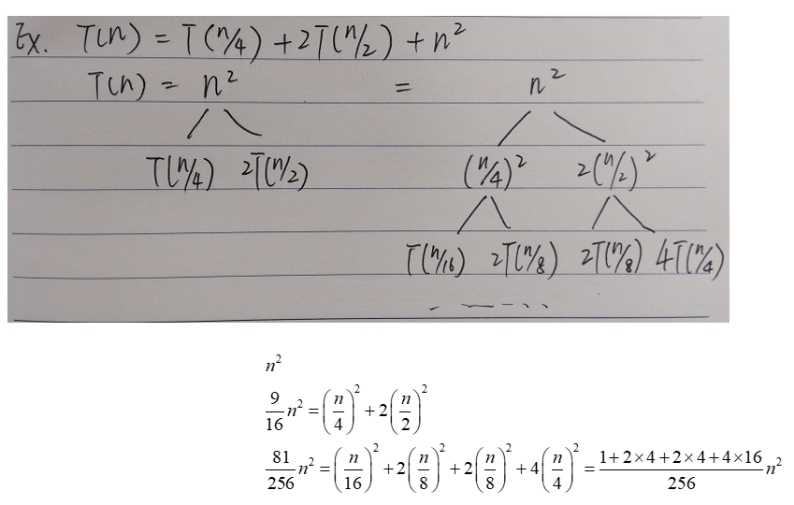

Slide 22
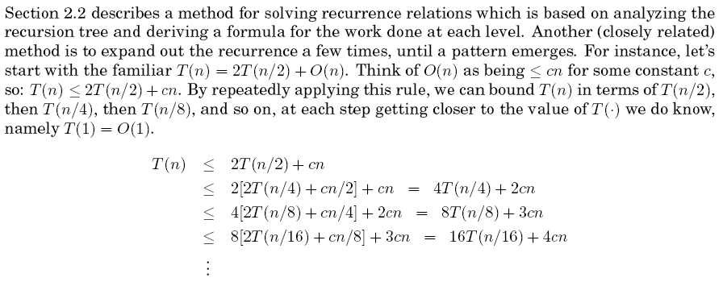
Exercise 1
22

Slide 23
2026/3/27
23

Slide 24
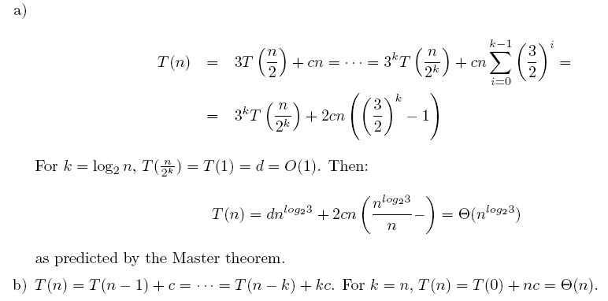
2026/3/27
≤
≤… ≤
≤
≤… ≤

Slide 25
Exercise 2
2026/3/27
25

Slide 26
O(n^{d}log₃n)=O(n²log₃n)
26

Slide 27
Exercise 3
27

Slide 28
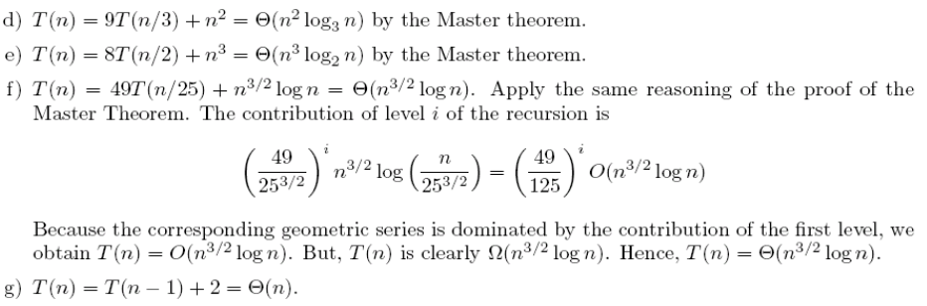
Exercise 3
2026/3/27

Slide 29
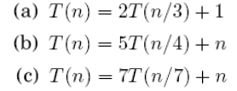
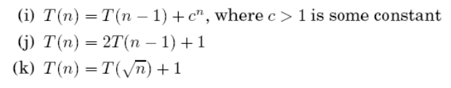
Exercise
Solving the following recurrence relations and give a θ bound for each of them

Slide 30
